Slide 1

POLYMORPHISM

Slide 2
POLYMORPHISM
Polymorphism is derived from 2 Greek words:
Poly → Many
Morphs → Forms
The process of representing one Form in multiple forms is known as Polymorphism.
Performing one task in different ways called Polymorphism

Slide 3

Real life example of Polymorphism
Suppose if you are in class room, that time you have to behave like a student, when you are in market, at that time you behave like a customer, when you at your home at that time you behave like a son or daughter, Here one person have different-different behaviors.

Slide 4
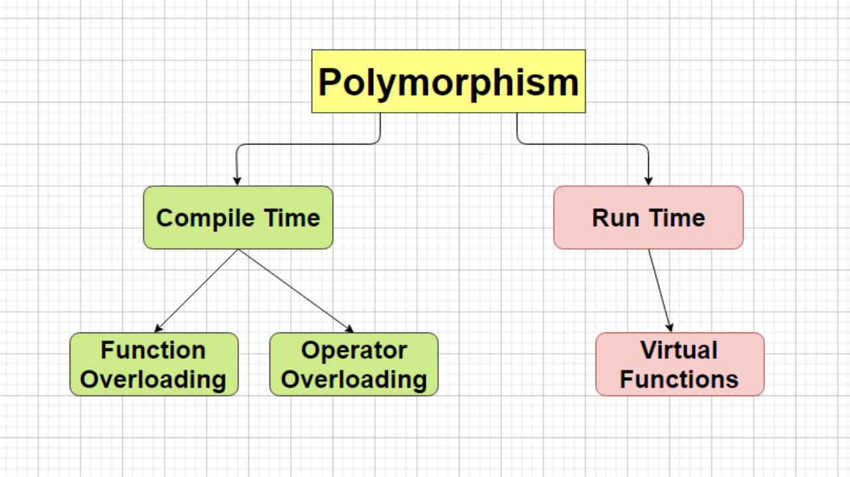
Type of Polymorphism

Slide 5
Static polymorphism:
Static polymorphism is also known as early binding and compile-time polymorphism.
In static polymorphism memory will be allocated at compile-time.
Dynamic polymorphism:
Dynamic polymorphism is also known as late binding and run-time polymorphism.
In dynamic polymorphism memory will be allocated at run-time.

Slide 6
Function/Method Overloading
Whenever same method name is existing multiple times in the same class with different number of parameter or different order of parameters or different types of parameters is known as method overloading.
In next example method "sum()" is present in Addition class with same name but with different signature or arguments.

Slide 7
Program: (fn overloading)
#include<iostream>
using namespace std;
class Addition{
public:
void sum(int a,int b){
cout<<"Addition of two number is:"<<a+b<<endl;
}
void sum(int a, int b, int c){
cout<<"Addition of three number is:"<<a+b+c<<endl;
}
};
int main(){
Addition add;
add.sum(2,5);
add.sum(3,5,7);
return 0;
}
Output:
Addition of two number is:7
Addition of three number is:15

Slide 8
Operator Overloading
The process of making an operator to exhibit different behaviors in different instances is known as operator overloading.
Only predefined operator can be overloaded.
Types Of Operator Overloading
Unary operator overloading.
These Operators have only single operand.
Examples:- ++,--,~,!
Binary operator overloading.
These operators can have two or more operands.
Examples:-+,-,*,/,%,^,=,==,+=,&,&& etc

Slide 9
Program: (unary operator overloading)
#include<iostream>
using namespace std;
class Space{
int x,y,z;
public:
void getData(){
cout<<"Enter 3 numbers"<<endl;
cin>>x>>y>>z;
}
void display(){
cout<<"x = "<<x<<endl;
cout<<“y = "<<y<<endl;
cout<<“z = "<<z<<endl;
}

Slide 10
void operator +(){
x=-x;
y=-y;
z=-z;
}
};
int main(){
Space s;
s.getData();
+s;
s.display();
return 0;
}
Output:
Enter 3 numbers
4
5
6
x = -4
y = -5
z = -6

Slide 11
Virtual Function
A virtual function is a member function that is declared as virtual within a base class and redefined by a derived class.
To create virtual function, precede the base version of function’s declaration with the keyword virtual.
Here we use a pointer to the base class to refer to all the derived objects.
The method name and type signature should be same for both base and derived version of function.

Slide 12
Program: (with virtual function)
#include<iostream>
using namespace std;
class A{
public:
virtual void show(){
cout<<"Content of base class"<<endl;
}
};
class B:public A{
public:
void show(){
cout<<"Content of derived class"<<endl;
} };
int main(){
A *bptr;
B b;
bptr=&b;
bptr->show();
return 0;
}
Output:
Content of derived class

Slide 13
Program: (without virtual function)
#include<iostream>
using namespace std;
class A{
public:
void show(){
cout<<"Content of base class"<<endl;
}
};
class B:public A{
public:
void show(){
cout<<"Content of derived class"<<endl;
} };
int main(){
A *bptr;
B b;
bptr=&b;
bptr->show();
return 0;
}
Output:
Content of base class

